Slide 1
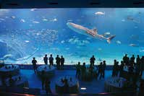
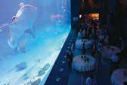
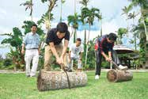
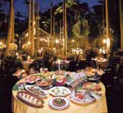
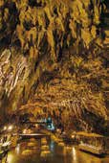
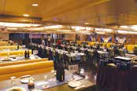
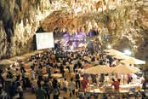
The reason why holding your MICE in Okinawa
Attractive venues
Events can be arranged for between 30 and 100 guests.
Events can be arranged for between 20 and 1500 guests.
Okinawa Churaumi Aquarium Party
Southeast Botanical Gardens Garden Party
The Kuroshio Sea tank is the main feature of the aquarium, which recreates the sea of Okinawa. With huge fish swimming in the background, you and your guest can hold a party in the fantastic atmosphere.
In this 148,760m2 space, you can hold a garden party of any scale or propose, that can be experienced nowhere else. Hold parties of up to 1,500 people, surrounded by tropical Okinawa greenery.
Events can be arranged for between 2 and 300 guests.
Events can be arranged for between 30and 350 guests.
Moby Dick Restaurant Ship Dinner Cruise
CAVE PARTY at Valley of Gangala
The largest cruise ship in Okinawa offers a dinner party with live music and spectacular sunset and night time views.
This unique venue uses natural limestone caves, the site of ancient archaeological finds. You can hold parties and concerts in a natural space, with no worries even if it rains.

